Slide 1
Prediction Challenges

Slide 2
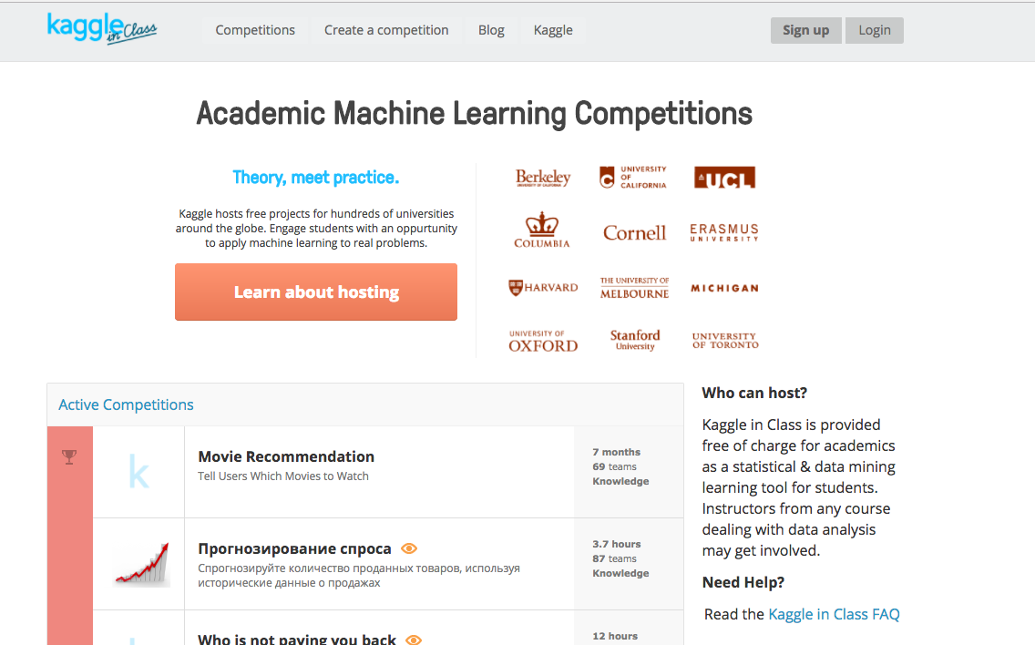
Kaggle Registration
Use the link https://inclass.kaggle.com/
Use the sign up on the top right

Slide 3
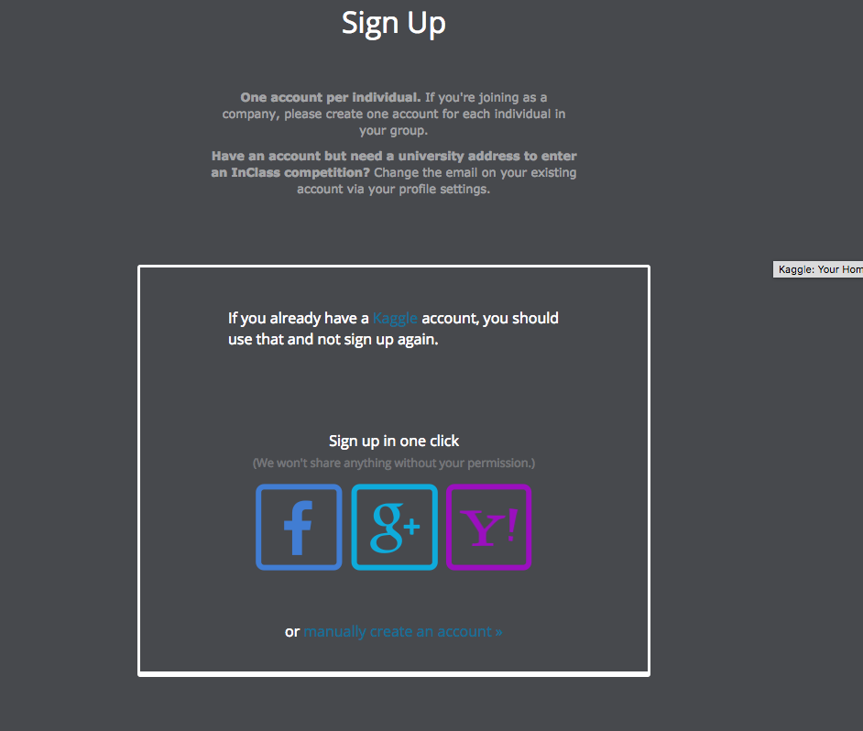
Kaggle Registration
Use your Rutgers email id only.
Create an account manually
Enter the details and get started

Slide 4
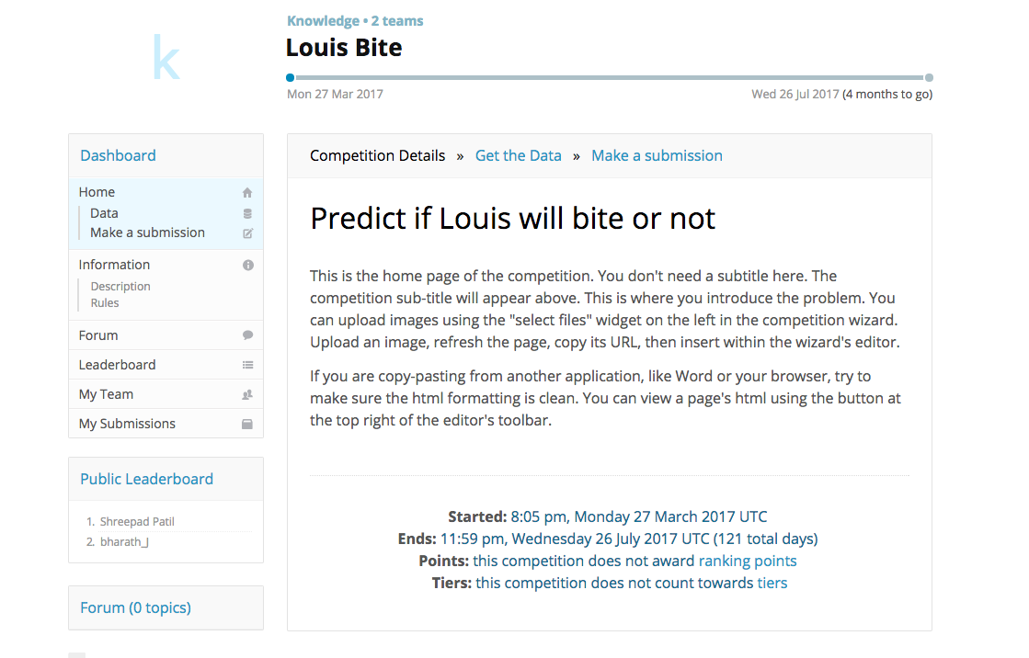
Accessing Data
Use the link shared on sakai to access the weekly assignment
Data is uploaded on Sakai as well
https://inclass.kaggle.com/c/louis-bite

Slide 5
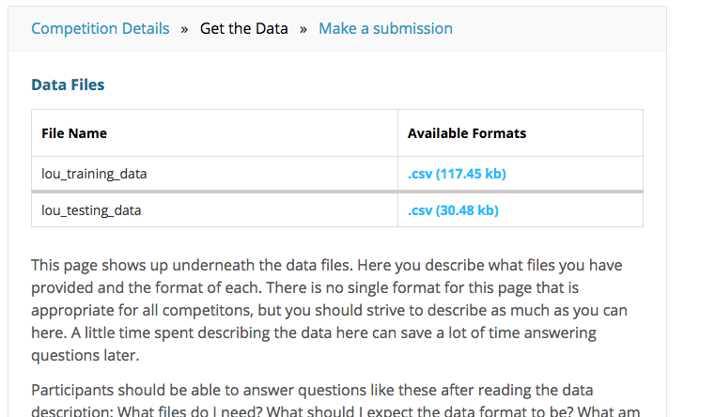
Accessing Data
Click the data link from the dashboard on the left and download the lou_training_data and lou_testing_data

Slide 6
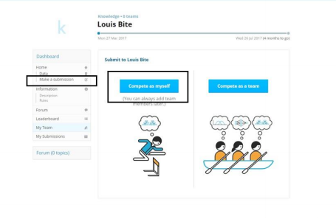
Making a Submission
Select ‘Make a Submission’ from the left dashboard to make a submission. Select the Compete as myself option

Slide 7
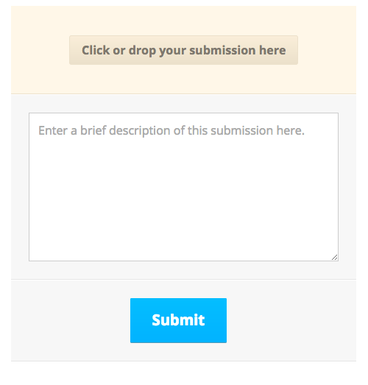
Making a Submission
Attach the csv file you have created and submit it.
The number of submissions are restricted to one

Slide 8
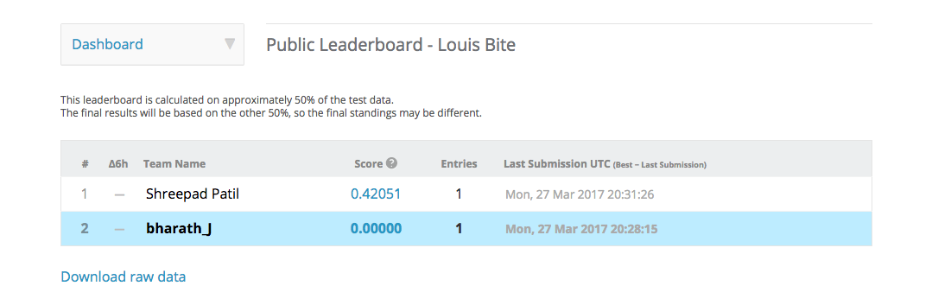
Leaderboard
Select leader board from the dashboard. Here you can check where you stand in the class.

Slide 9
Grading and Plagiarism
Here, only 10％ of your prediction are scored, we call it public rows and 90% will be scored until the competition ends. You ranking now is based on public rows(10%) of your results.
You can only use one account to submit your result; if we find two accounts for the same person, we will treat it as unfair means and deduct points.
At the same time, you should submit your final edition on Sakai to enable us to check your submission.

Slide 10
Sample Submission File
Use the Sample submission file on Sakai to make a submission on sakai.
This would give no formatting errors on submission by kaggle.

Slide 11
THANK YOU

